Slide 1


Chicago Car Crashes Project
COURSE: DATA 606 CAPSTONE IN DATA SCIENCE
PROFESSOR: DR. CHAOJIE WANG
PRESENTED BY: VIVEK PANDEY
University of Maryland, Baltimore County DEPT - Data Science Program

Slide 2

JOURNEY
our
Introduction and info of dataset Problem Statement EDA Visualizations Classification models used Model results Areas for exploration GITHUB Link

Slide 3


INTRODUCTION
The main motive of this project is to build a model to predict the severity of a traffic crashes based on Chicago Police Department crash dataset.
The dataset has been taken from the government website: https://data.cityofchicago.org/Transportation/Traffic-Crashes-Crashes/85ca-t3if
- Using the data from "Chicago Car Crash Dataset" which as more than 569700 records. The dataset as details of date and time of accident occurred, location and cause of accident and soon.

Slide 4
PROBLEM STATEMENT
- Cleaning the data and making it suitable for use and visualizing the data by use of graphs
- Predicting the severity of a traffic crashes and the reasons for it by different models
- Demonstrated how different classification models work

Slide 5


EXPLORATORY DATA ANALYSIS
In this I summarized the main characteristics of the data and plotted them visually. As this dataset was large enough with null values so did not make any difference after cleaning and dropping few columns with duplicate values. In the EDA part I also plotted graphs without cleaning the data. Graphs will be shown in the upcoming slides.
EXPLORATORY DATA ANALYSIS

Slide 6
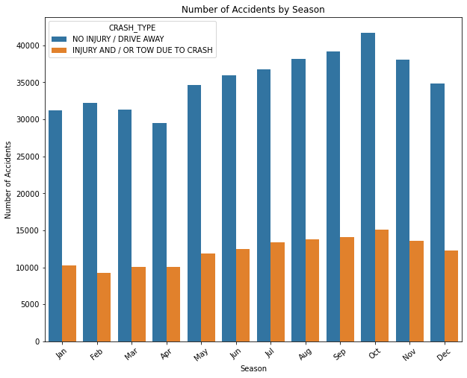
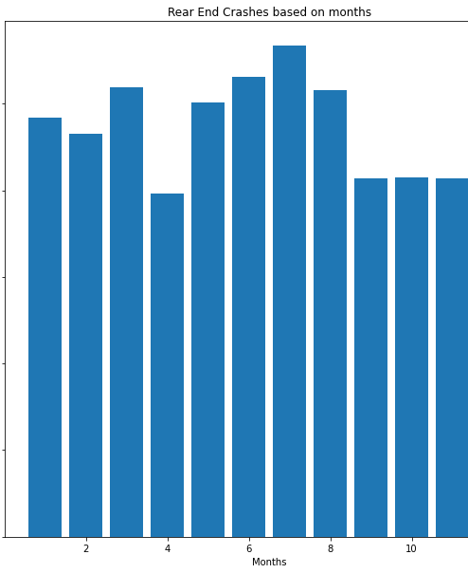
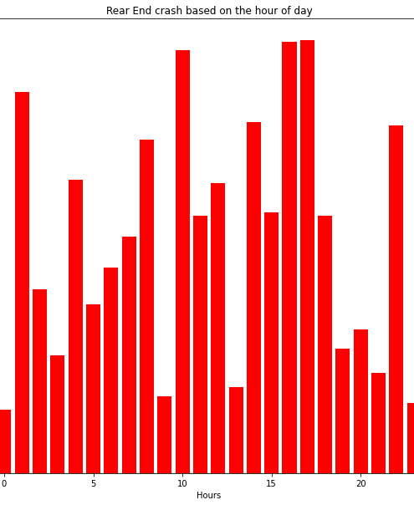
Visualization

Slide 7
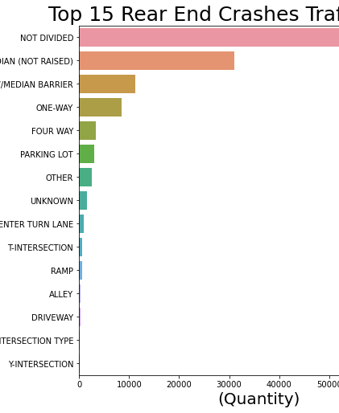
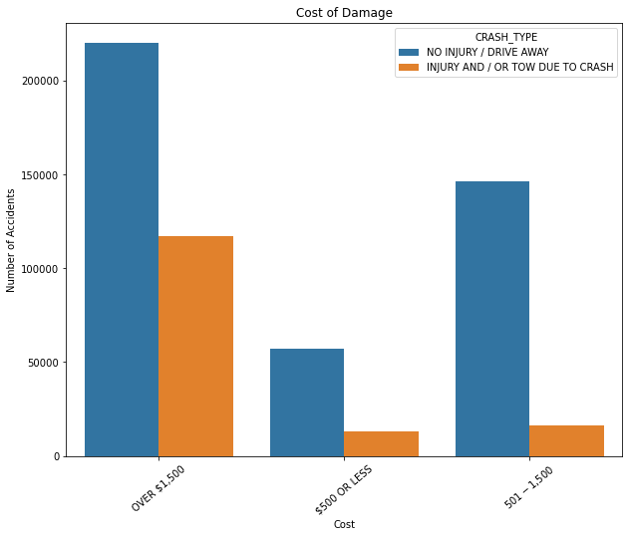
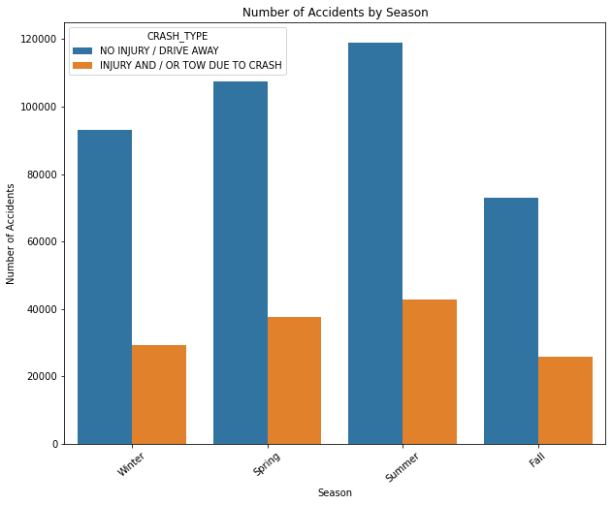
Visualization

Slide 8
Models used
1.Logistic Regression 2.Decision Tree Classifier 3.Random Forests Classifier

Slide 9
Model results
Logistic Regression
Accuracy Score Train: 0.5011080393189398
Accuracy Score Test: 0.4982183605406354
ROC_AUC Test: 0.5678102494291235
Vanilla - Decision Tree Classifier
Accuracy Score Train: 0.9996379673512374
Accuracy Score Test: 0.9993154291732491
ROC_AUC Test: 0.6686402160548042
Decision Tree Classifier
Accuracy Score Train: 0.999488766017202
Accuracy Score Test: 0.9993593119185536
ROC_AUC Test: 0.6624165642016512
Vanilla - Random Forest Classifier
Accuracy Score Train: 0.9581161137440758
Accuracy Score Test: 0.9565824117956819
ROC_AUC Test: 0.6847323467416125
ROC_AUC SCORE = 0.8290781329331086

Slide 10
Areas for exploration
I would like to explore this dataset more to find more ways to prevent the crashes. As we need more data as there could be other reasons of the crash too. We can run a clustering model.

Slide 11
Github link
https://github.com/DATA-606-FALL-2022/data606_Vivek

Slide 12

Thankyou

